Slide 1
Decision Tree
Ying shen
Sse, tongji university
OCT. 2016

Slide 2
Decision tree
We can solve a classification problem by asking a series of carefully crafted questions about the attributes of the test record.
Each time we receive an answer, a follow-up question is asked.
This process is continued until we reach a conclusion about the class label of the record.
色泽=？
青绿
...
... ...
根蒂=？
蜷缩
...
敲声=？
... ...
浊响
...
... ...
好瓜

Slide 3
Decision tree
The series of questions and answers can be organized in the form of a decision tree.
It is a hierarchical structure consisting of nodes and directed edges.
The tree has three types of nodes
  A root node that has no incoming edges, and zero or more outgoing edges.
  Internal nodes, each of which has exactly one incoming edge and two or more outgoing edges.
  Leaf or terminal nodes, each of which has exactly one incoming edge and no outgoing edges.

Slide 4
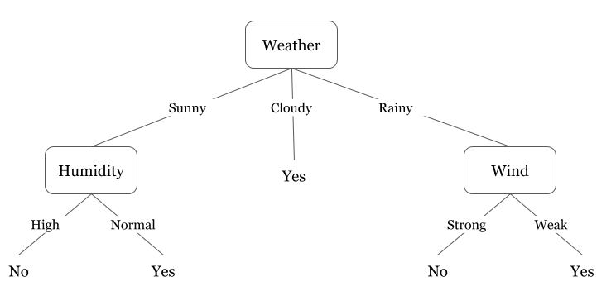
Decision tree
In a decision tree, each leaf node is assigned a class label.
The non-terminal nodes, which include the root and other internal nodes, contain attribute test conditions to separate records that have different characteristics.

Slide 5
Decision tree
Classifying a test record is straightforward once a decision tree has been constructed.
Starting from the root node, we apply the test condition.
We then follow the appropriate branch based on the outcome of the test.
This will lead us either to
  Another internal node, for which a new test condition is applied, or
  A leaf node.
The class label associated with the leaf node is then assigned to the record.

Slide 6
Decision tree construction
Efficient algorithms have been developed to induce a reasonably accurate, although suboptimal, decision tree in a reasonable amount of time.
These algorithms usually employ a greedy strategy that makes a series of locally optimal decisions about which attribute to use for partitioning the data.

Slide 7
Decision tree construction
A decision tree is grown in a recursive fashion by partitioning the training records into successively purer subsets.
We suppose
  U_{n} is the set of training records that are associated with node n.
  C={c₁, c₂,…, c_{K}} is the set of class labels.

Slide 8
Decision tree construction
If all the records in U_{n} belong to the same class c_{k}, then n is a leaf node labeled as c_{k}.
If U_{n} contains records that belong to more than one class,
  An attribute test condition is selected to partition the records into smaller subsets.
  A child node is created for each outcome of the test condition.
  The records in U_{n} are distributed to the children based on the outcomes.
The algorithm is then recursively applied to each child node.

Slide 9
Decision tree construction
For each node, let p(c_{k}) denotes the fraction of training records from class k.
In most cases, the leaf node is assigned to the class that has the majority number of training records.
The fraction p(c_{k}) for a node can also be used to estimate the probability that a record assigned to that node belongs to class k.

Slide 10
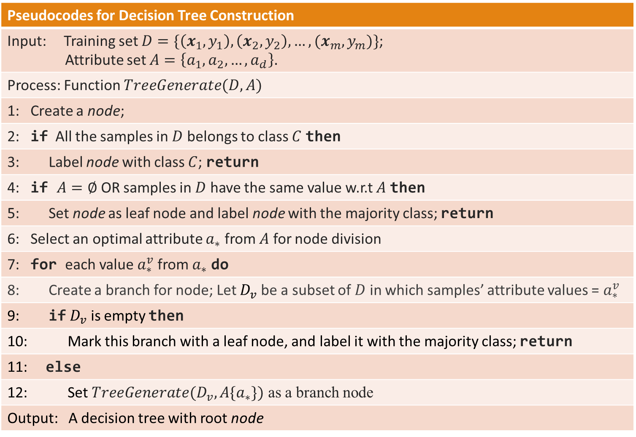
Decision tree construction
Pseudocodes for Decision Tree Construction
Input: Training set $D=\{\left(x_{1},y_{1}\right),\left(x_{2},y_{2}\right),…,(x_{m},y_{m})\}$; Attribute set $A=\left\{a_{1},a_{2},…,a_{d}\right\}.$
Process: Function $TreeGenerate(D, A)$
1: Create a node;
2: if All the samples in $D$ belongs to class $C$ then
3: Label node with class $C$; return
4: if $A=∅$ OR samples in $D$ have the same value w.r.t $A$ then
5: Set node as leaf node and label node with the majority class; return
6: Select an optimal attribute $a_{∗}$ from $A$ for node division
7: for each value $a_{∗}^{v}$ from $a_{∗}$ do
8: Create a branch for node; Let $D_{v}$ be a subset of $D$ in which samples’ attribute values = $a_{∗}^{v}$
9: if $D_{v}$ is empty then
10: Mark this branch with a leaf node, and label it with the majority class; return
11: else
12: Set $TreeGenerate(D_{v}, A\{a_{∗}\})$ as a branch node
Output: A decision tree with root node

Slide 11
Attribute test
Each recursive step of the tree-growing process must select an attribute test condition to divide the records into smaller subsets.
To implement this step, the algorithm must provide
  A method for specifying the test condition for different attribute types and
  An objective measure for evaluating the goodness of each test condition.

Slide 12
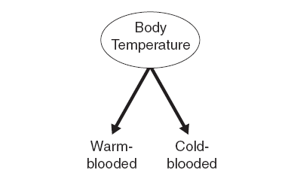
Attribute test
Binary attributes
  The test condition for a binary attribute generates two possible outcomes.

Slide 13
Attribute test
Nominal attributes
  A nominal attribute can produce binary or multiway splits.
  There are 2^{N-1}-1 ways of creating a binary partition of N attribute values.
  For a multiway split, the number of outcomes depends on the number of distinct values for the corresponding attribute.

Slide 14
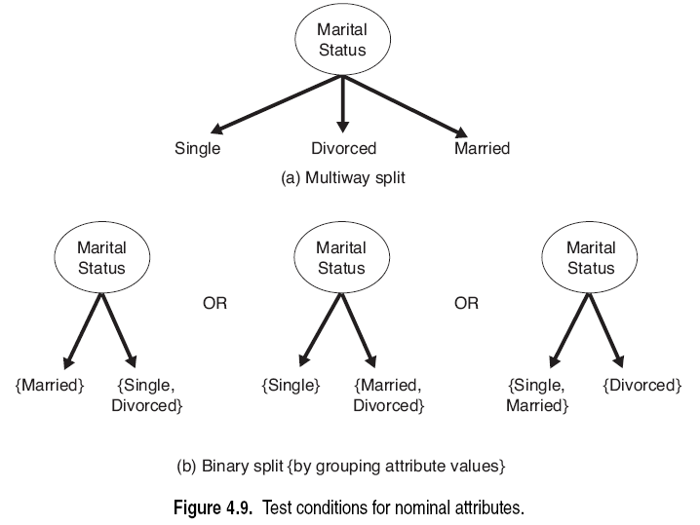
Attribute test

Slide 15
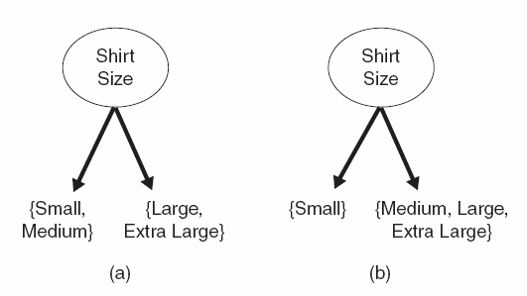
Attribute test
Ordinal attributes
  Ordinal attributes can also produce binary or multiway splits.
  Ordinal attributes can be grouped as long as the grouping does not violate the order property of the attribute values.

Slide 16
Attribute test
Continuous attributes
  The test condition can be expressed as a comparison test v≤T or v>T with binary outcomes, or
  A range query with outcomes of the form T_{j}≤v< T_{j+1}, for j=1,…,J
For the binary case
  The decision tree algorithm must consider all possible split positions T, and
  Select the one that produces the best partition.
For the multiway split,
  The algorithm must consider multiple split positions.

Slide 17
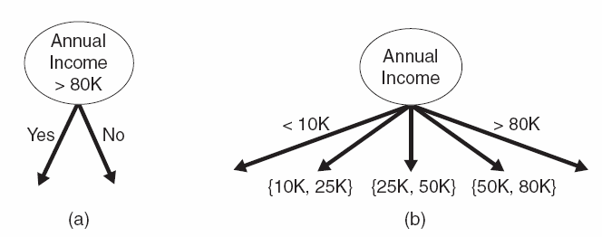
Attribute test

Slide 18
Decision tree construction: Example
Example: credit risk estimation
An individual’s credit risk depends on such attributes as credit history, current debt, collateral and income.
For this example, there exists a decision tree which can correctly classify all the objects.

Slide 19
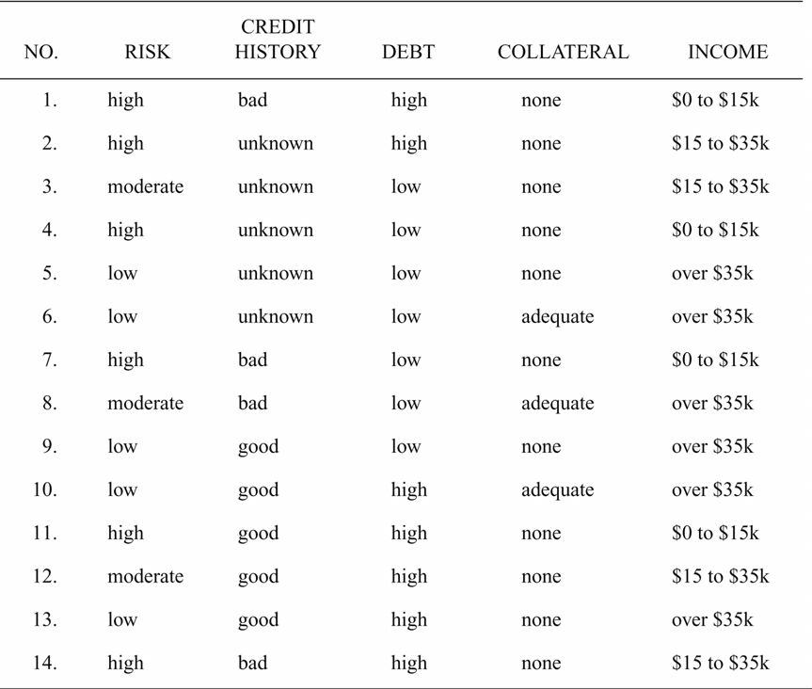
Decision tree construction: Example

Slide 20
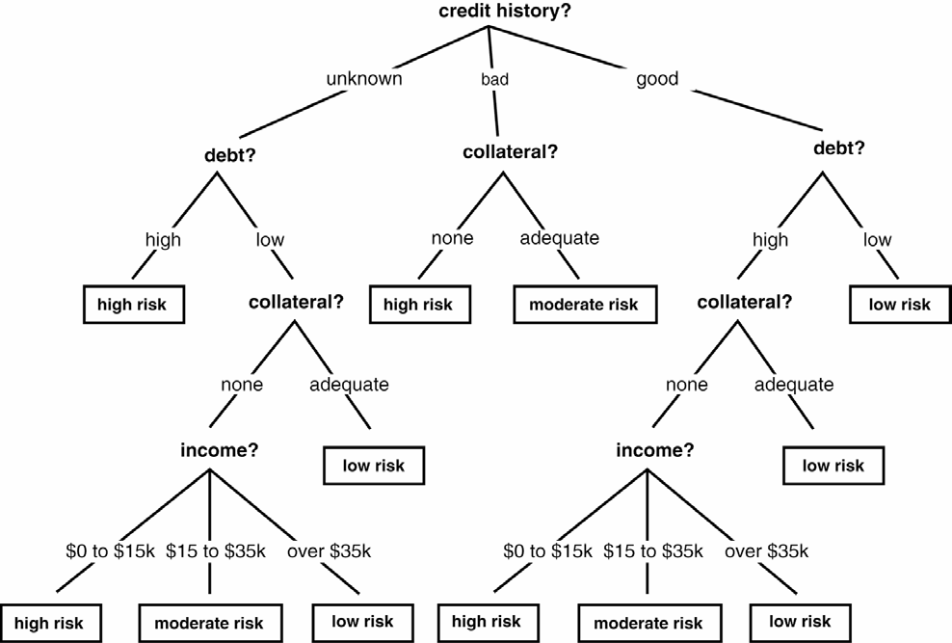
Decision tree construction: Example

Slide 21
Decision tree construction: Example
In a decision tree, each internal node represents a test on some attribute, such as credit history or debt.
Each possible value of that attribute corresponds to a branch of the tree.
Leaf nodes represent classifications, such as low or moderate risk.

Slide 22
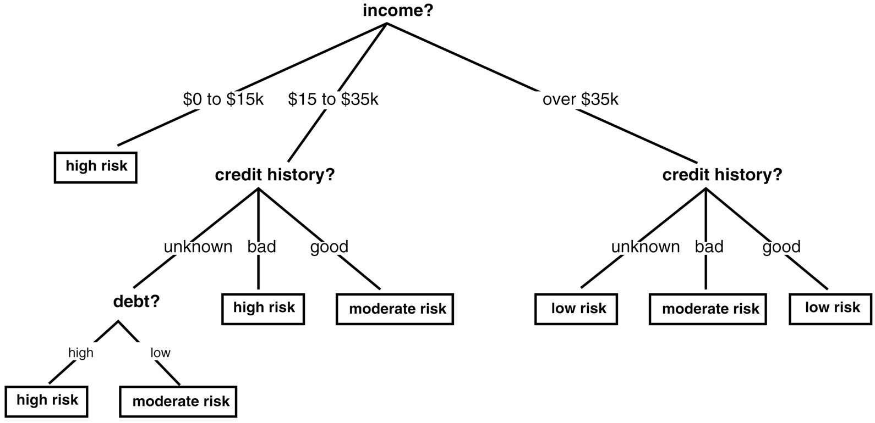
Decision tree construction: Example

Slide 23
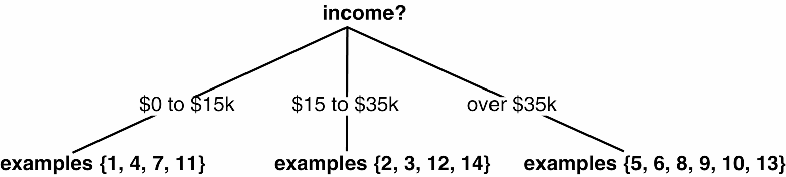
Decision tree construction: Example
Suppose income is selected as the root attribute to be tested.
This partitions the example set as shown in the figure.

Slide 24
Decision tree construction: Example
Since the partition {1,4,7,11} consists entirely of high-risk individuals, a leaf node is created.

Slide 25
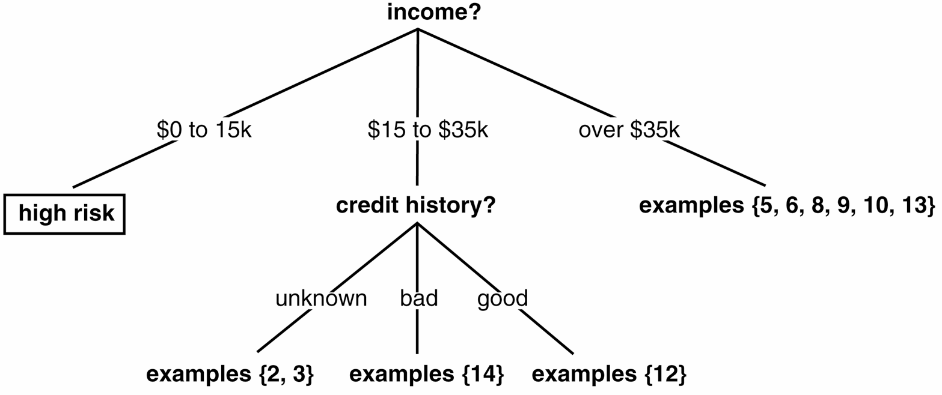
Decision tree construction: Example
For the partition {2,3,12,14}
  credit history is selected as the attribute to be tested.
  This further divides this partition into {2,3}, {14} and {12}.

Slide 26
Information theoretic test
Each attribute of an instance contributes a certain amount of information to the classification process.
We measure the amount of information gained by the selection of each attribute.
We then select the attribute that provides the greatest information gain.

Slide 27
Information theoretic test
Information theory provides a mathematical basis for measuring the information content of a message.
We may think of a message as an instance in a collection of possible messages.
The information content of a message depends on
  The size of this collection
  The frequency with which each possible message occurs.

Slide 28
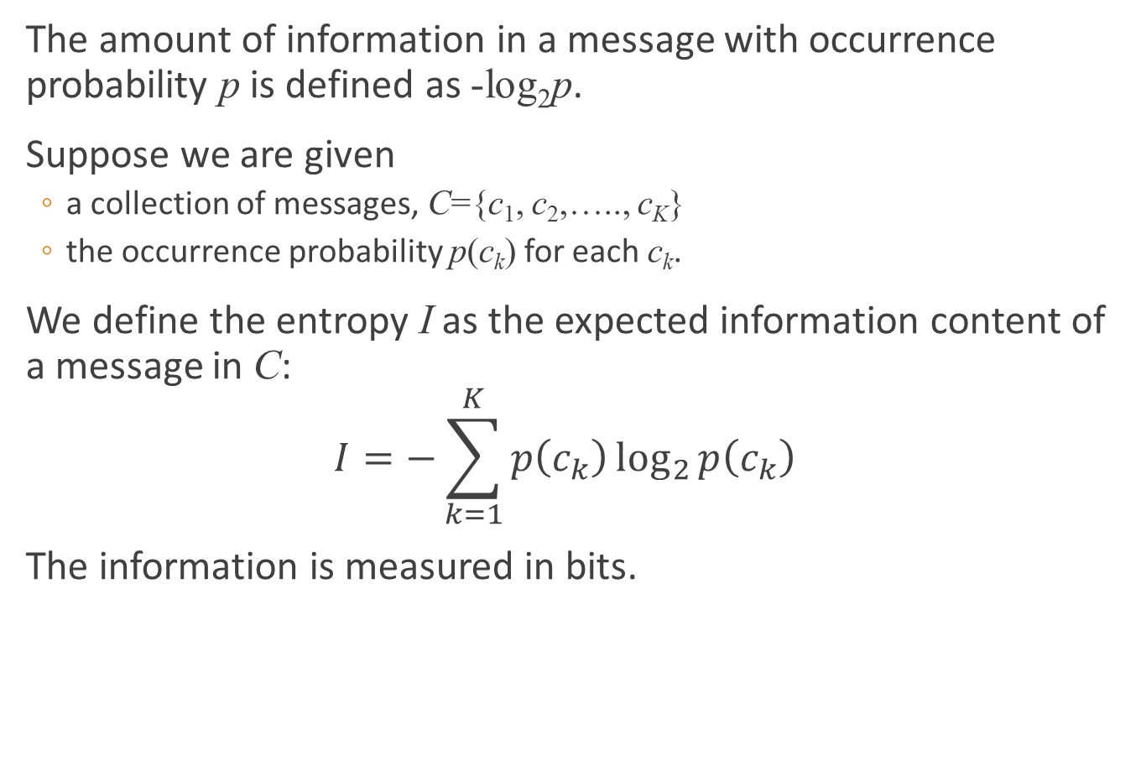
Information theoretic test
The amount of information in a message with occurrence probability p is defined as -log₂p.
Suppose we are given
  a collection of messages, C={c₁, c₂,….., c_{K}}
  the occurrence probability p(c_{k}) for each c_{k}.
We define the entropy I as the expected information content of a message in C:
$$I=−\sum_{k=1}^{K}{p\left(c_{k}\right)\log_{2}{p\left(c_{k}\right)}}$$
The information is measured in bits.

Slide 29
Information theoretic test
We can measure the information content of a set of training instances from the probabilities of occurrences of the different classes.
In our example
  p(high risk)=6/14
  p(moderate risk)=3/14
  p(low risk)=5/14

Slide 30
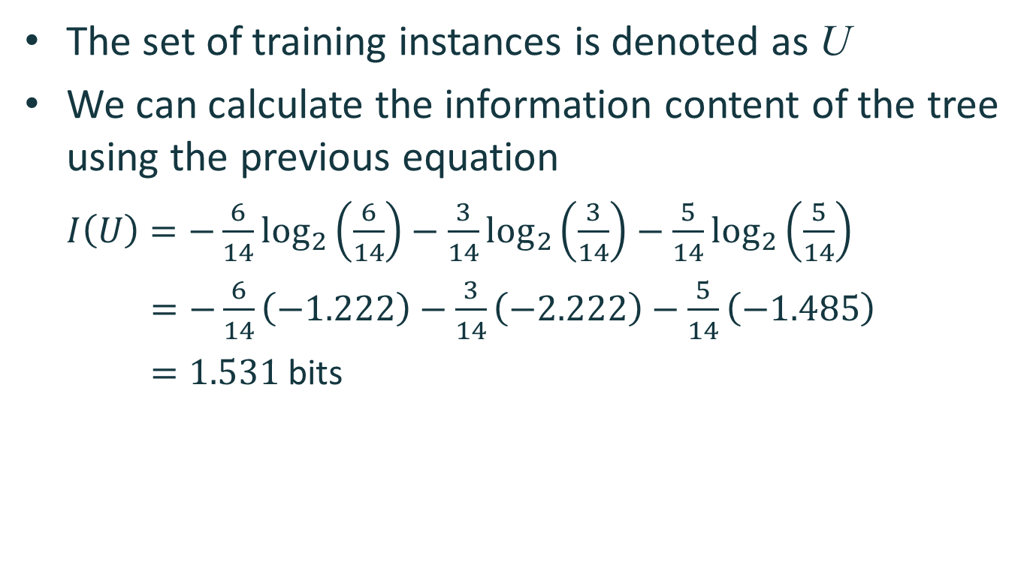
Information theoretic test
The set of training instances is denoted as U
We can calculate the information content of the tree using the previous equation
$I\left(U\right)=−\frac{6}{14}\log_{2}\left(\frac{6}{14}\right)−\frac{3}{14}\log_{2}\left(\frac{3}{14}\right)−\frac{5}{14}\log_{2}\left(\frac{5}{14}\right)$
$=−\frac{6}{14}\left(−1.222\right)−\frac{3}{14}\left(−2.222\right)−\frac{5}{14}\left(−1.485\right)$
$=1.531$ bits

Slide 31
Information theoretic test
The information gain provided by making a test at a node is the difference between
  The amount of information needed to complete the classification before performing the test.
  The amount of information needed to complete the classification after performing the test.
The latter is defined as the weighted average of the information in all its subtrees.

Slide 32

Information theoretic test
If we select attribute P, with N values, this will partition U into subsets {U₁,U₂,…,U_{N}}.
The average information required to complete the classification after selecting P is
$$\overline{I}\left(P\right)=\sum_{n=1}^{N}{\frac{\left|U_{n}\right|}{\left|U\right|}I(U_{n})}$$

Slide 33
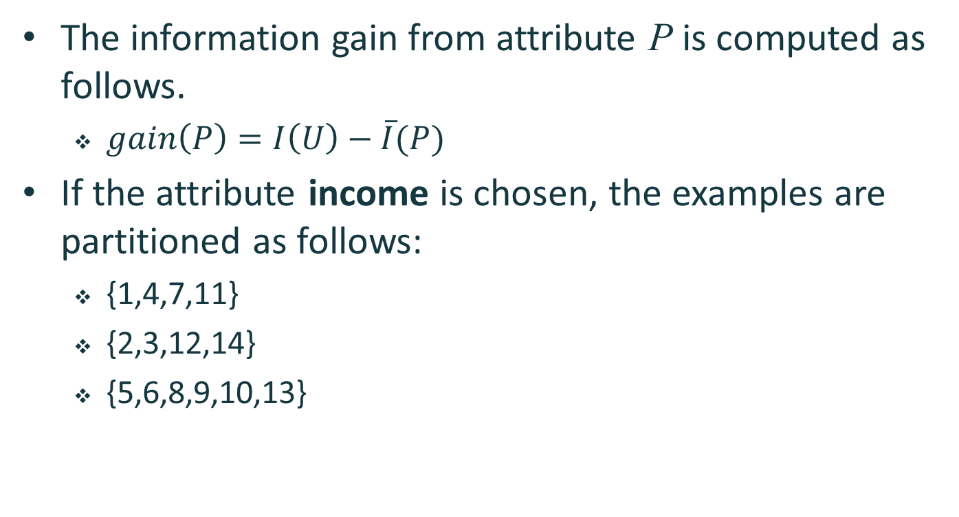
Information theoretic test
The information gain from attribute P is computed as follows.
  $gain\left(P\right)=I\left(U\right)−\overline{I}(P)$
If the attribute income is chosen, the examples are partitioned as follows:
  {1,4,7,11}
  {2,3,12,14}
  {5,6,8,9,10,13}

Slide 34

Information theoretic test
The expected information needed to complete the classification is
$\overline{I}\left(income\right)=\frac{4}{14}I\left(U_{1}\right)+\frac{4}{14}I\left(U_{2}\right)+\frac{6}{14}I(U_{3})$
$=\frac{4}{14}\left(0.0\right)+\frac{4}{14}\left(1.0\right)+\frac{6}{14}\left(0.650\right)$
$=0.564$ bits

Slide 35
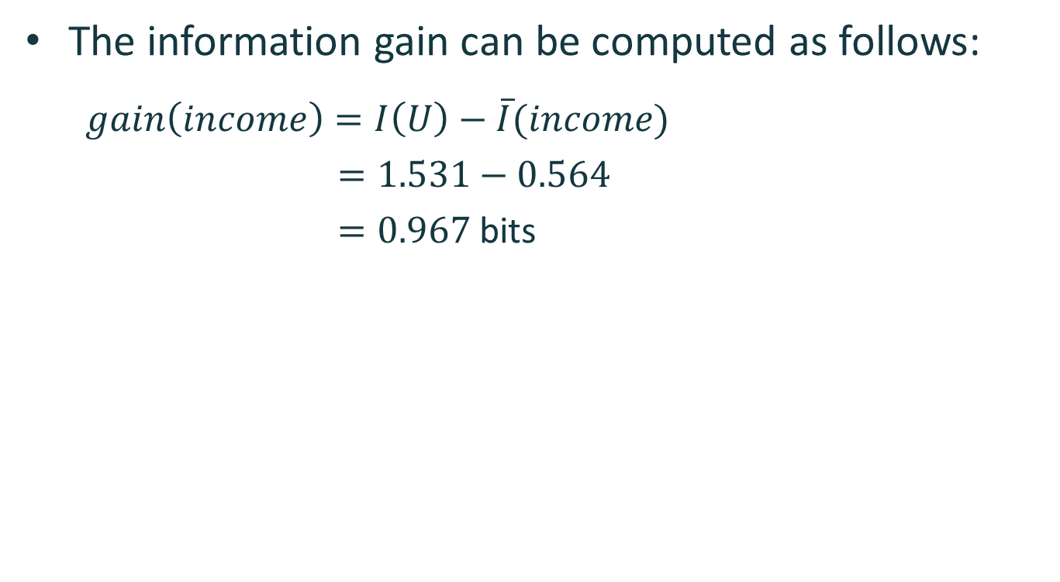
Information theoretic test
The information gain can be computed as follows:
$gain\left(income\right)=I\left(U\right)−\overline{I}(income)$
$=1.531−0.564$
$=0.967$ bits

Slide 36
Information theoretic test
Similarly, we can show that
  gain(credit history)=0.266
  gain(debt)=0.063
  gain(collateral)=0.207
The attribute income will be selected, since it provides the greatest information gain.

Slide 37
Continuous attributes
If attribute P has continuous numeric values v, we can apply a binary test.
The outcome of the test depends on a threshold value T.
There are two possible outcomes:
  v≤T
  v>T
The training set is then partitioned into 2 subsets U₁and U₂.

Slide 38
Continuous attributes
We apply sorting to values of attribute P to result in the sequence {v₁, v₂,…, v_{R}}.
Any threshold between v_{r} and v_{r+1}will divide the set into two subsets
  {v₁, v₂,…, v_{r}}
  {v_{r+1}, v_{r+2},…, v_{R}}
There are R-1 possible splits.

Slide 39
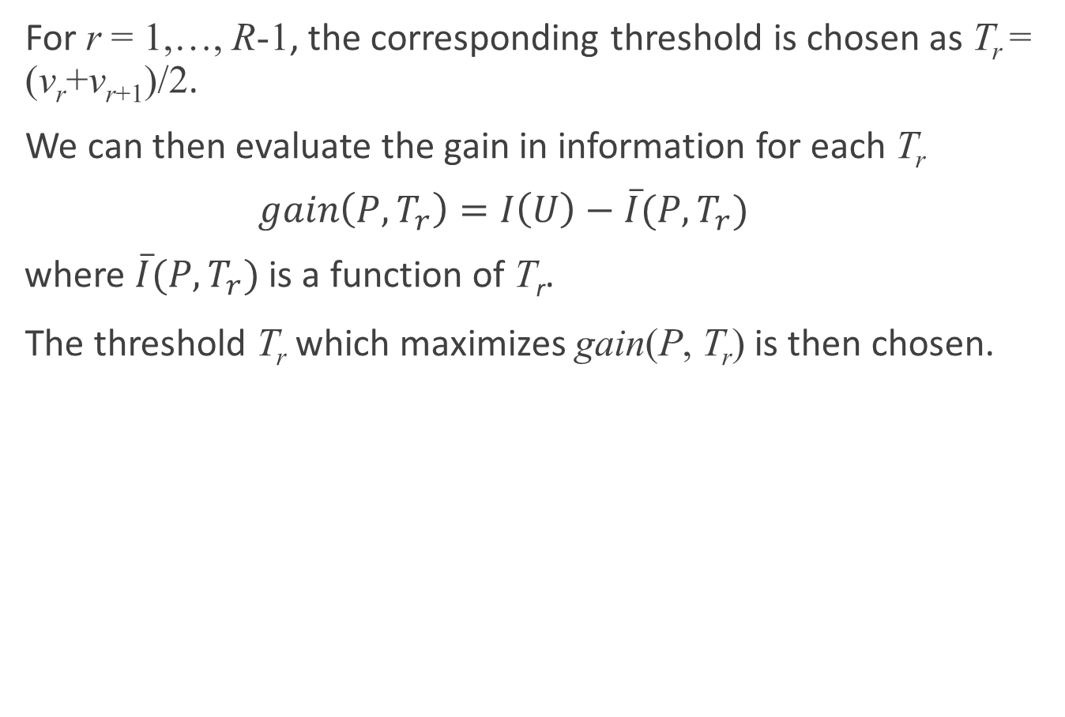
Continuous attributes
For r = 1,…, R-1, the corresponding threshold is chosen as T_{r} = (v_{r}+v_{r+1})/2.
We can then evaluate the gain in information for each T_{r}
  $$gain\left(P,T_{r}\right)=I\left(U\right)−\overline{I}(P,T_{r})$$
  where $\overline{I}(P,T_{r})$ is a function of T_{r}.
The threshold T_{r} which maximizes gain(P, T_{r}) is then chosen.

Slide 40
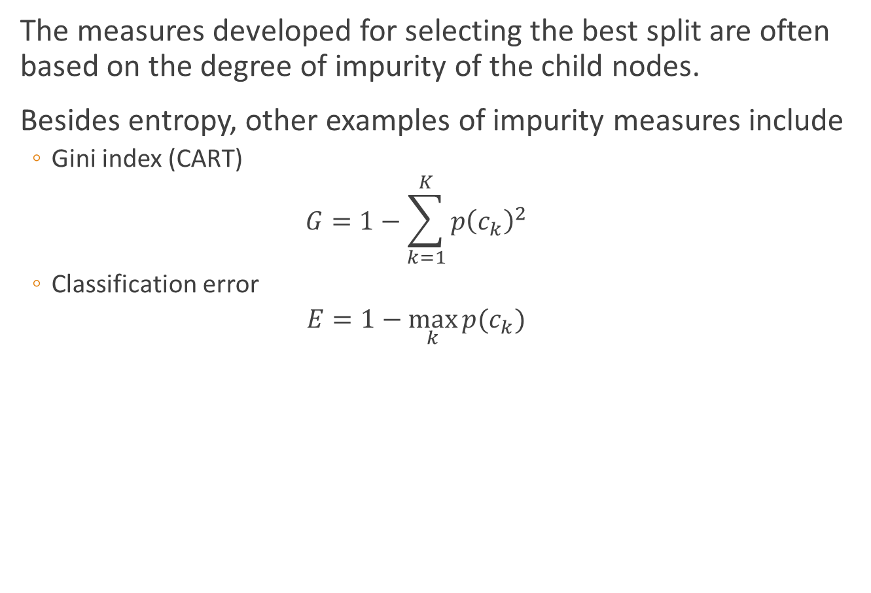
Impurity measures
The measures developed for selecting the best split are often based on the degree of impurity of the child nodes.
Besides entropy, other examples of impurity measures include
  Gini index (CART)
  $$G=1−\sum_{k=1}^{K}{p{\left(c_{k}\right)}^{2}}$$
  Classification error
  $$E=1−\max_{k}{p(c_{k})}$$

Slide 41
Impurity measures
In the following figure, we compare the values of the impurity measures for binary classification problems.
p refers to the fraction of records that belong to one of the two classes.
All three measures attain their maximum value when p=0.5.
The minimum values of the measures are attained when p equals 0 or 1.

Slide 42
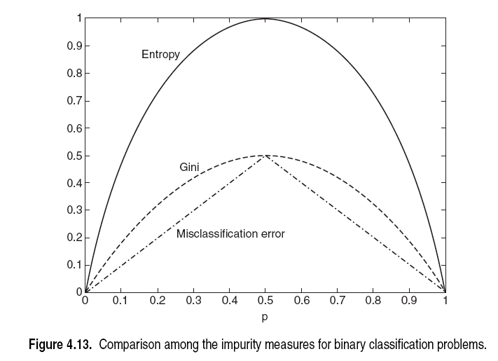
Impurity measures

Slide 43
Gain ratio
Impurity measures such as entropy and Gini index tend to favor attributes that have a large number of possible values.
In many cases, a test condition that results in a large number of outcomes may not be desirable.
This is because the number of records associated with each partition is too small to enable us to make any reliable predictions.

Slide 44
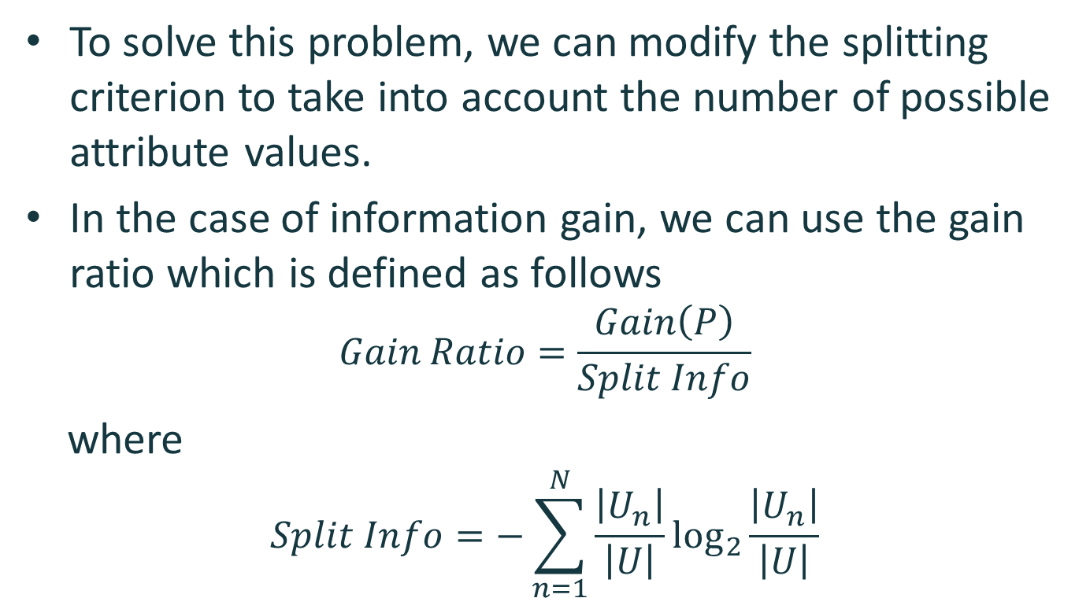
Gain ratio
To solve this problem, we can modify the splitting criterion to take into account the number of possible attribute values.
In the case of information gain, we can use the gain ratio which is defined as follows
$$Gain Ratio=\frac{Gain\left(P\right)}{Split Info}$$
where
$$Split Info=−\sum_{n=1}^{N}{\frac{\left|U_{n}\right|}{\left|U\right|}\log_{2}{\frac{\left|U_{n}\right|}{\left|U\right|}}}$$

Slide 45
Pruning
Decision trees that are too large are susceptible to a phenomenon known as overfitting.
A tree pruning step can be performed to reduce the size of the decision tree.
Pruning helps by trimming the tree branches in a way that improves the generalization error.
Create a validation set to evaluation the performance of current decision tree
Notes:
预剪枝：在决策树生成过程中，对每个结点在划分前先进行估计，若当前结点的划分不能带来决策树泛化性能的提升，则停止划分并将当前结点标记为叶节点；
后剪枝：：先从训练集生成一颗完整的决策树，然后自底向上地对非叶节点进行考察，若将该结点对应的子树替换为叶节点能带来决策树泛化性能提升，则将该子树替换成叶节点

Slide 46
Pruning
Training set
编号 | 色泽 | 根蒂 | 敲声 | 纹理 | 脐部 | 触感 | 好瓜
1 | 青绿 | 蜷缩 | 浊响 | 清晰 | 凹陷 | 硬滑 | 是
2 | 乌黑 | 蜷缩 | 沉闷 | 清晰 | 凹陷 | 硬滑 | 是
3 | 乌黑 | 蜷缩 | 浊响 | 清晰 | 凹陷 | 硬滑 | 是
6 | 青绿 | 稍蜷 | 浊响 | 清晰 | 稍凹 | 软粘 | 是
7 | 乌黑 | 稍蜷 | 浊响 | 稍糊 | 稍凹 | 软粘 | 是
10 | 青绿 | 硬挺 | 清脆 | 清晰 | 平坦 | 软粘 | 否
14 | 浅白 | 稍蜷 | 沉闷 | 稍糊 | 凹陷 | 硬滑 | 否
15 | 乌黑 | 稍蜷 | 浊响 | 清晰 | 稍凹 | 软粘 | 否
16 | 浅白 | 蜷缩 | 浊响 | 模糊 | 平坦 | 硬滑 | 否
17 | 青绿 | 蜷缩 | 沉闷 | 稍糊 | 稍凹 | 硬滑 | 否

Slide 47
Pruning
Test set
编号 | 色泽 | 根蒂 | 敲声 | 纹理 | 脐部 | 触感 | 好瓜
4 | 青绿 | 蜷缩 | 沉闷 | 清晰 | 凹陷 | 硬滑 | 是
5 | 浅白 | 蜷缩 | 浊响 | 清晰 | 凹陷 | 硬滑 | 是
8 | 乌黑 | 稍蜷 | 浊响 | 清晰 | 稍凹 | 硬滑 | 是
9 | 乌黑 | 稍蜷 | 沉闷 | 稍糊 | 稍凹 | 硬滑 | 否
11 | 浅白 | 硬挺 | 清脆 | 模糊 | 平坦 | 硬滑 | 否
12 | 浅白 | 蜷缩 | 浊响 | 模糊 | 平坦 | 软粘 | 否
13 | 青绿 | 稍蜷 | 浊响 | 稍糊 | 凹陷 | 硬滑 | 否

Slide 48
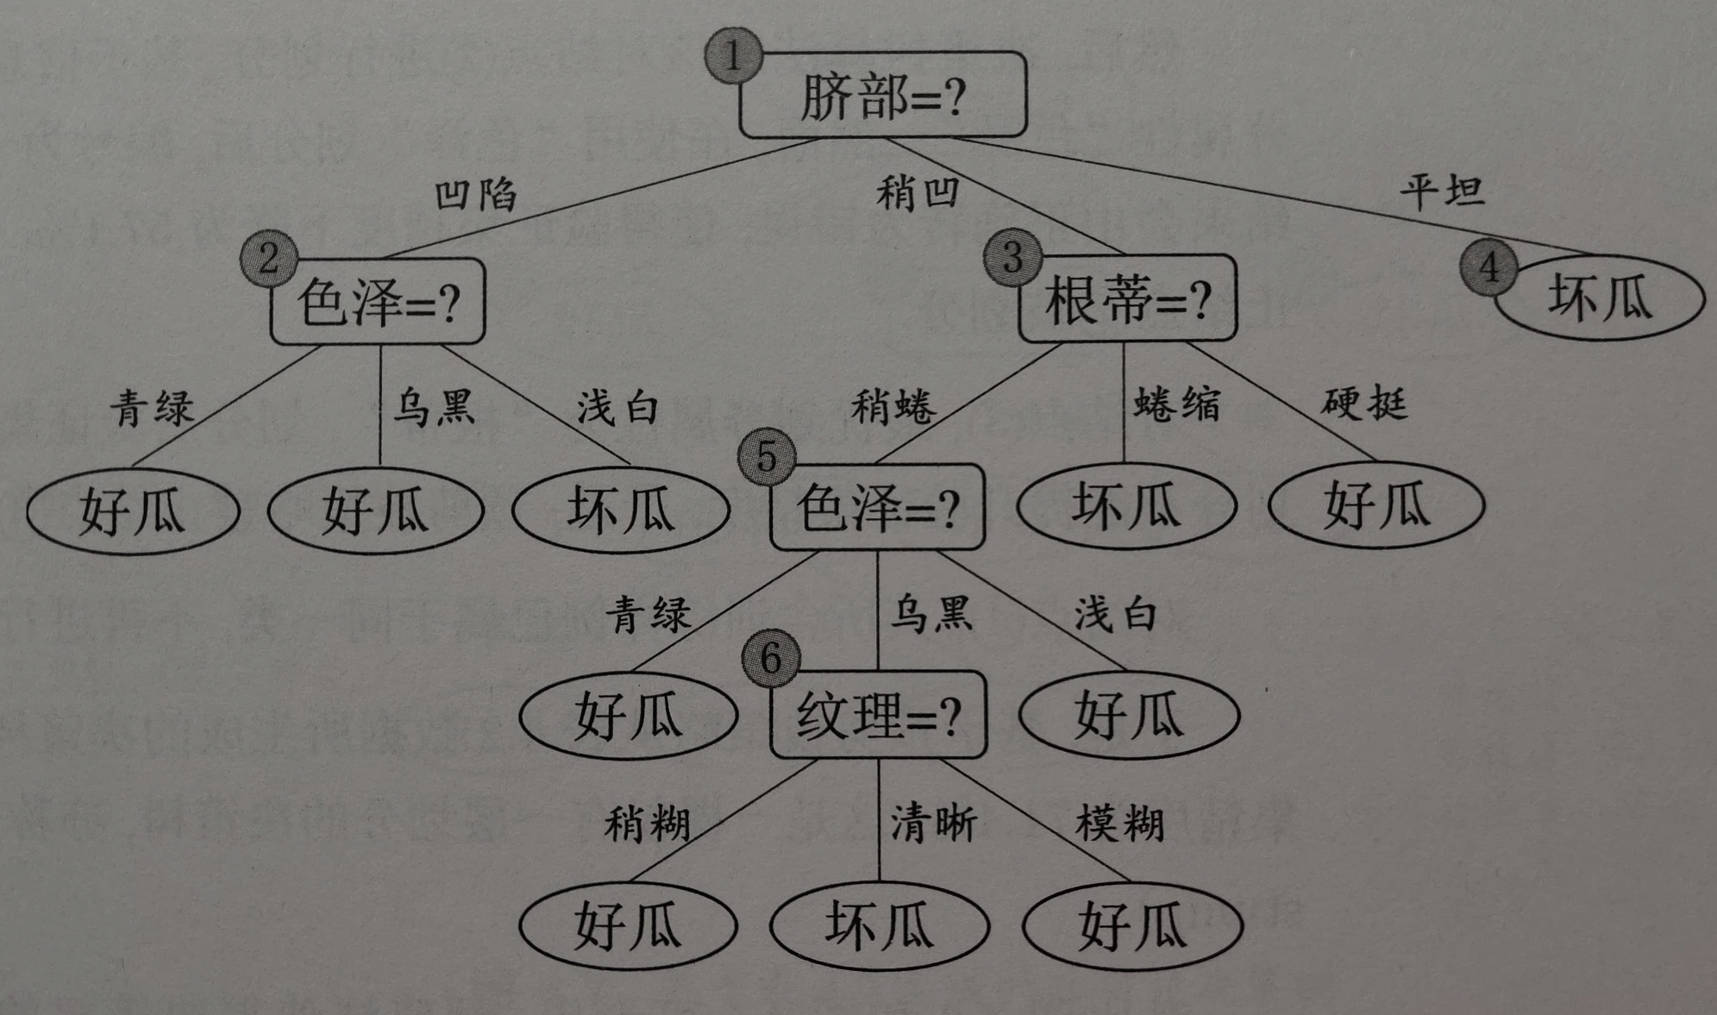
Prepruning
Before pruning
{10,16}
{11,12}
{1}
{2,3}
{14}
{17}
{4,13}
{5}
{6}
{7}
{15}
{9}
{8}
Notes:
Accuracy: 3/7=0.429

Slide 49

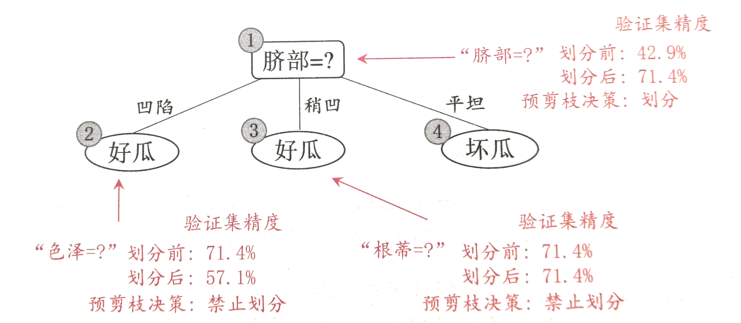
Prepruning
Node : Before node division After node division
{4,5,8,9,11,12,13} (是) {4,5}(是) {8,9,13}(是) {11,12}(否)
Node : Before node division After node division
{4,5}(是) {4}(是) {5}(否)

Slide 50
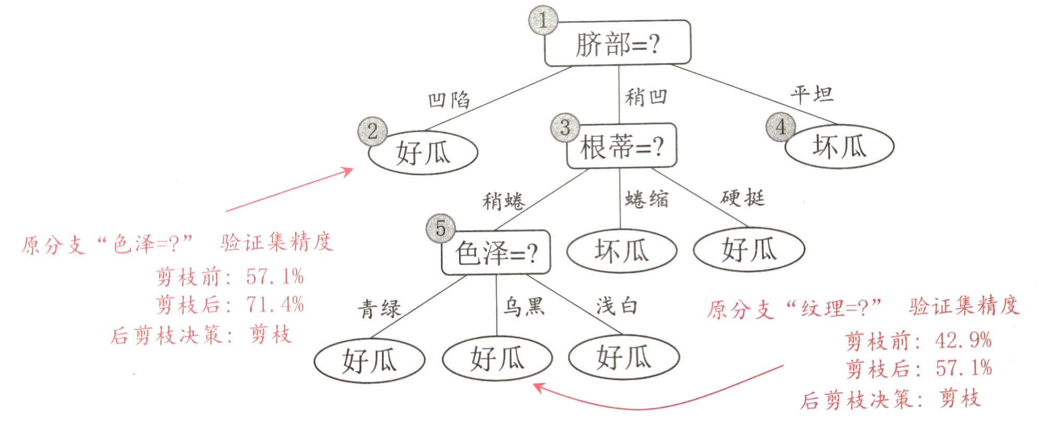
Postpruning
Node : After pruning, label the node “是”. Sample {5} can be correctly classified after pruning.
{4,5,13}
{8,9}

Slide 51
Multivariate decision tree
The test condition described so far involve using only a single attribute at a time.
The tree-growing procedure can be viewed as the process of partitioning the attribute space into disjoint regions.
The border between two neighboring regions of different classes is known as a decision boundary.

Slide 52
Multivariate decision tree
Since the test condition involves only a single attribute, the decision boundaries are rectilinear, i.e., parallel to the coordinate axes.
This limits the expressiveness of the decision tree representation for modeling complex relationships among continuous attributes.

Slide 53
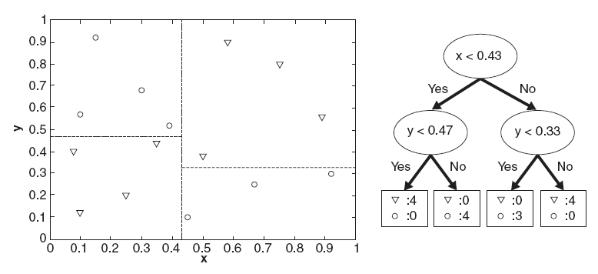
Multivariate decision tree

Slide 54
Multivariate decision tree
An oblique decision tree allows test conditions that involve more than one attribute.
The following figure illustrates a data set that cannot be classified effectively by a conventional decision tree.
This data set can be easily represented by a single node of an oblique decision tree with the test condition x+y<1

Slide 55
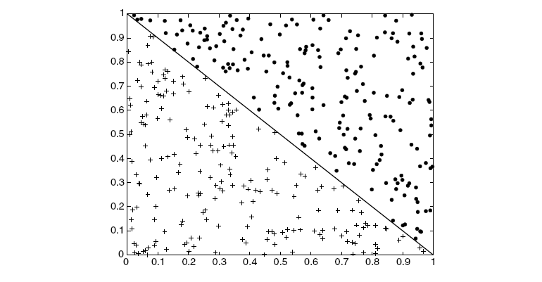
Multivariate decision tree

Slide 56



Multivariate decision tree
Attribute tests are performed on attribute combinations
An internal node is a linear classifier $\sum_{i=1}^{d}{w_{i}a_{i}}=t$
  $w_{i}$ and $t$ can be learned from the training set
Example
-0.800*密度-0.044*含糖率$≤$-0.313?
是
否
-0.365*密度+0.366*含糖率$≤$-0.158?
坏瓜
是
否
坏瓜
好瓜

Slide 57
Multivariate decision tree

